Slide 1
Window Programming 1-3
Basic component: NumericUpDown

Slide 2
NumericUpDown
Up and down button for number
  Value
  Increment
  Minimum
  Maximum
Event
  ValueChanged

Slide 3
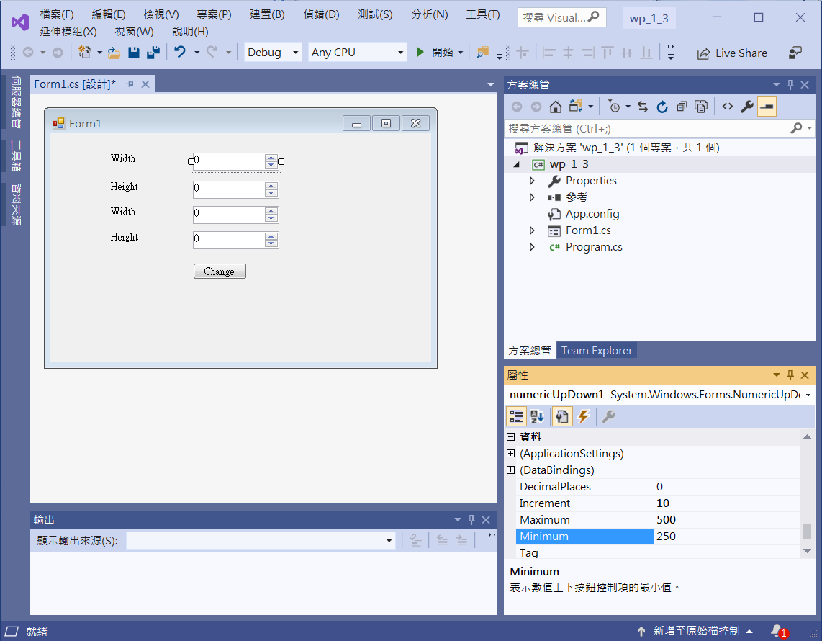
NumericUpDown
label1
numericUpDown1
label2
numericUpDown2
label3
numericUpDown3
label4
numericUpDown4
numericUpDown1~4
Increment -> 10
Maximum -> 500
Minimum -> 250
button1

Slide 4
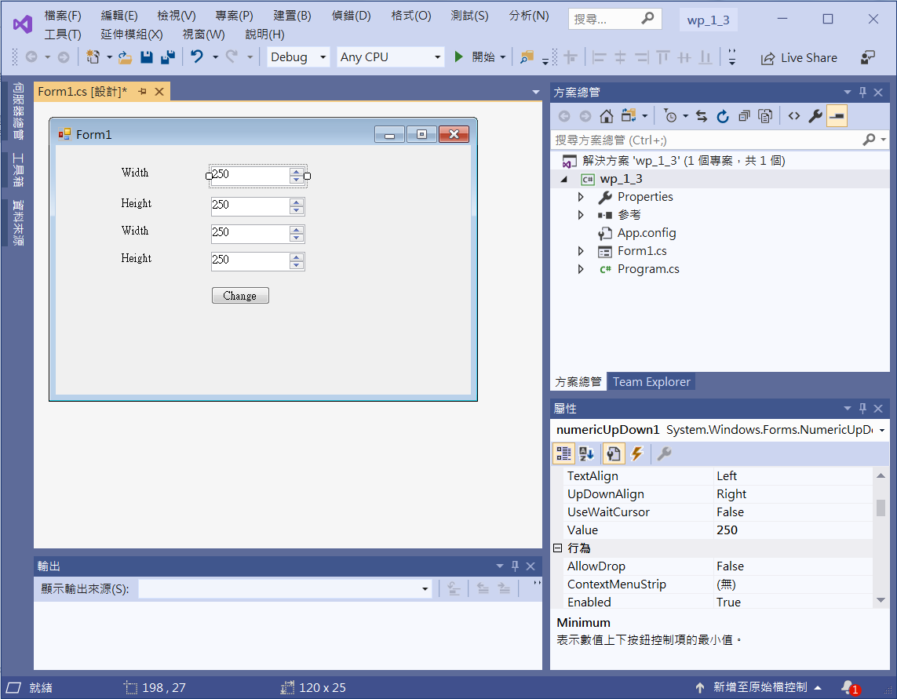
NumericUpDown
numericUpDown1
Value -> 250

Slide 5
NumericUpDown
private void NumericUpDown1_ValueChanged(object sender, EventArgs e)
{
Size = new Size(Convert.ToInt32(numericUpDown1.Value), Convert.ToInt32(numericUpDown2.Value));
}
private void NumericUpDown2_ValueChanged(object sender, EventArgs e)
{
Size= new Size(Convert.ToInt32(numericUpDown1.Value), Convert.ToInt32(numericUpDown2.Value));
}

Slide 6
NumericUpDown
private void Button1_Click(object sender, EventArgs e)
{
Size =new Size(Convert.ToInt32(numericUpDown3.Value), Convert.ToInt32(numericUpDown4.Value));
}

Slide 7
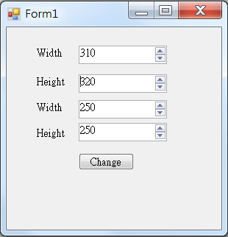
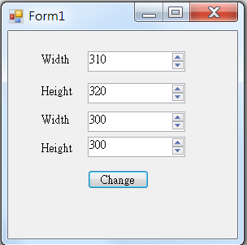
Exercise#1-3

